Slide 1
#1 Understanding the Financial Planning Process

Slide 2
The Rewards of Sound Financial Planning
Improving Your Standard of Living
Spending Money Wisely
Accumulating Wealth

Slide 3
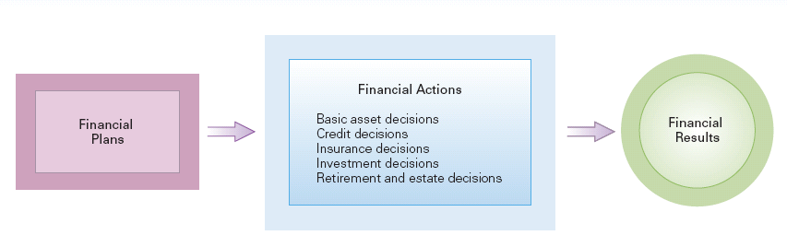
Organizational Planning Model

Slide 4
Average American Family
Notes:
Description of the table: Incomes and assets averages are given for all families, self-employed, and retired families in relation to what is earned, what they are worth, home ownership, and savings.

Slide 5

The Personal Financial Planning Process
Systematic process that considers important elements of an individual’s financial affairs in order to fulfill financial goals

Slide 6
Six-Step Financial Planning Process
1. Define financial goals.
2. Develop financial plans and strategies to achieve goals.
3. Implement financial plans and strategies.
4. Periodically develop and implement budgets to monitor and control progress against goals.
5. Use financial statements to evaluate results of plans and budgets, taking corrective action as required.
6. Redefine goals and revise plans and strategies as personal circumstances change.

Slide 7

The Role of Money
Medium of exchange: used to measure value
Utility: amount of satisfaction derived from purchases versus cost
Link to personal psychological concepts and key role in personal relationships

Slide 8

Putting Target Dates on Financial Goals
Long-term: 6 years or more
Intermediate-term: the next 2-5 years
Short-term: in the next year

Slide 9

From Goals to Plans: A Lifetime of Planning
Early childhood
High school and college
Family formation
Career development
Pre-retirement
Retirement

Slide 10
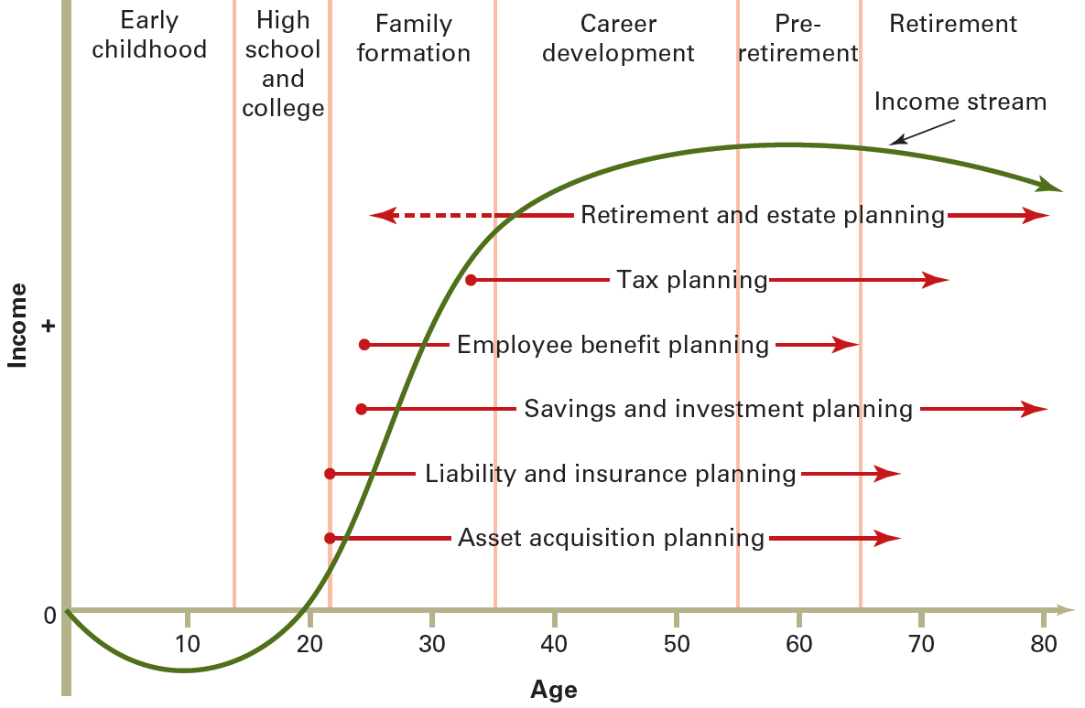
Personal Financial Planning Life Cycle

Slide 11
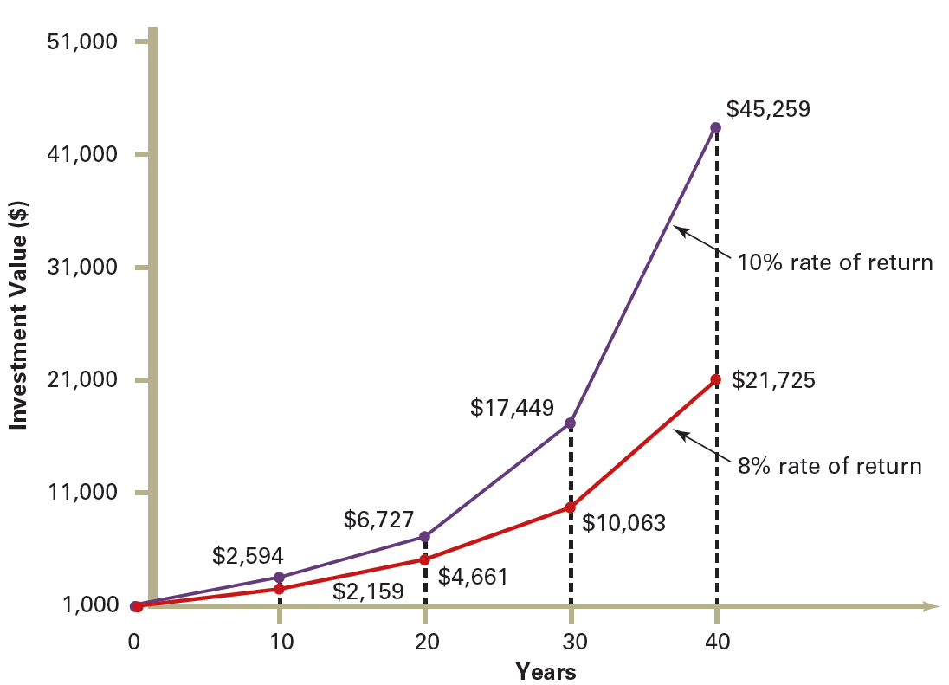
How a $1,000 Investment Grows over Time

Slide 12
Special Planning Concerns
Managing Two Incomes
Managing Employee Benefits
Managing Finances in Tough Economic Times
Adapting to Other Major Life Changes

Slide 13
Technology in Financial Planning
Technology streamlines the number crunching and information gathering involved in financial planning.
Reasonably priced and user-friendly programs are available such as Microsoft Money and Quicken packages.
Internet provides useful, relevant financial planning Web sites.

Slide 14
Using Professional Financial Planners
Commission-based planners earn commission on selling financial products
Fee-only planners charge fees based on complexity of prepared plans
Hybrid approach involves both charging fees and collecting commissions

Slide 15
The Planning Environment
Financial planning environment contains various interrelated groups of players, each fulfilling certain goals.
Government
Business
Consumers

Slide 16
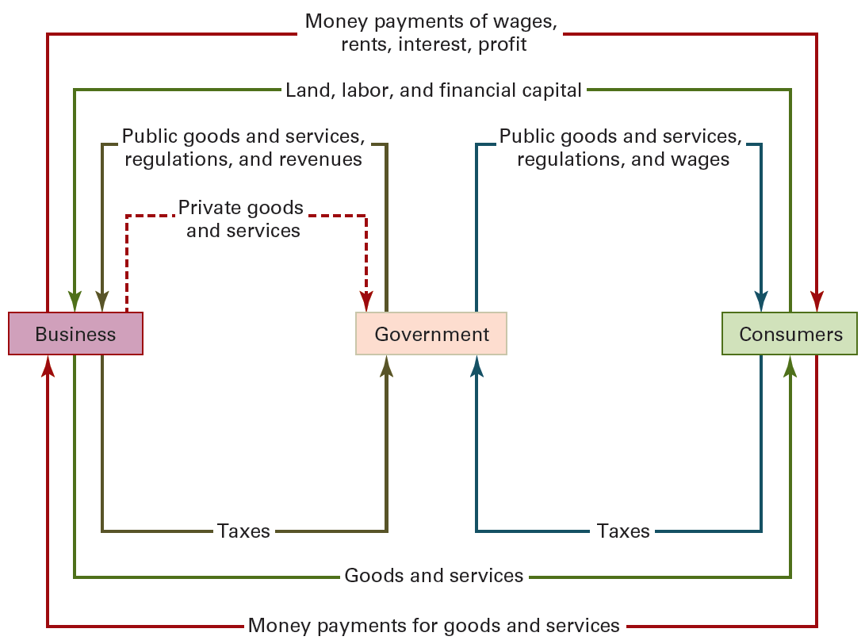
Financial Planning Environment

Slide 17
Government
Federal government plays a major role in regulating the level of economic activity
Taxation and regulation constrain personal financial planning

Slide 18
The Economy
Monetary Policy
Controls money supply
Used to stimulate or contract economic growth
Fiscal Policy
Controls levels of taxation
Sets levels of government spending

Slide 19
The Economy (Part 2)
Economic Cycles
Stages related to employment and production levels
Growth measured by changes in GDP
Inflation
Measured by changes in CPI
Affects purchasing power and interest rates
Affects financial plans and goals

Slide 20
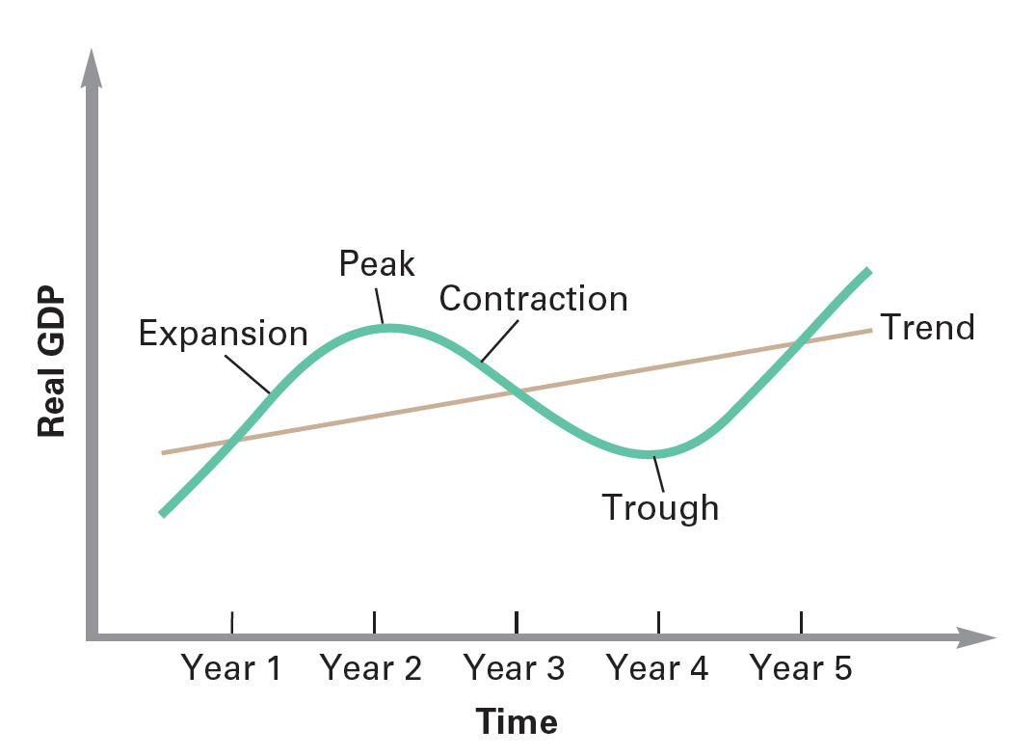
Exhibit 1.7: The Business Cycle
The business cycle consists of four stages: expansion, peak, contraction, and trough

Slide 21

What Determines Your Personal Income?
Demographics and income
Age, marital status
Education
Where you live
Career

Slide 22
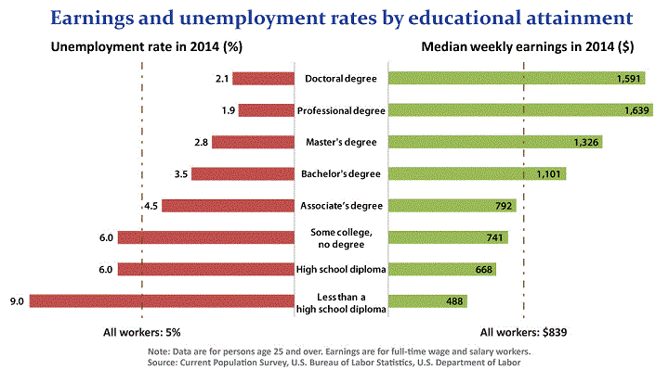
How Age and Education Affect Family Income
Notes:
Description of the table: Ages and annual incomes for heads of household, as well as education levels and average incomes are given.

